Slide 1
Modul 5b XML
Session 3, 25-11-2020
Dr. Jaap Geraerts

Slide 2
Linked Open Data: what
Existence of many (online) datasets
Structured in different ways, based on different technologies
Finding ways to link existing datasets and to make them interoperable

Slide 3
Linked Open Data: why
Querying several datasets instead of working in an ‘information silo’
Building upon the work of others (reusing & enriching data)
Sharing data (Open Science)

Slide 4
Linked Open Data: how
Work with Linked Open Data (LOD) standards
Data should be well-formatted and standardized
Good documentation is essential

Slide 5
Uniform Resource Identifier (URI)
Providing a unique ID to an object in the data
Link within dataset to particular object (see AOR example)
Link to object in external dataset
Creating one’s own identifiers
Making use of existing authority files

Slide 6
URI – XML example
Many possibilities to attribute ID in XML:
<person name=‘Willem’>
The above value is not neccessarily unique.
<person name=‘Willem’ ID=‘P00000001’>
Tip: create IDs which contain some data which make them more readable (e.g. ‘P’ denoting a person)

Slide 7
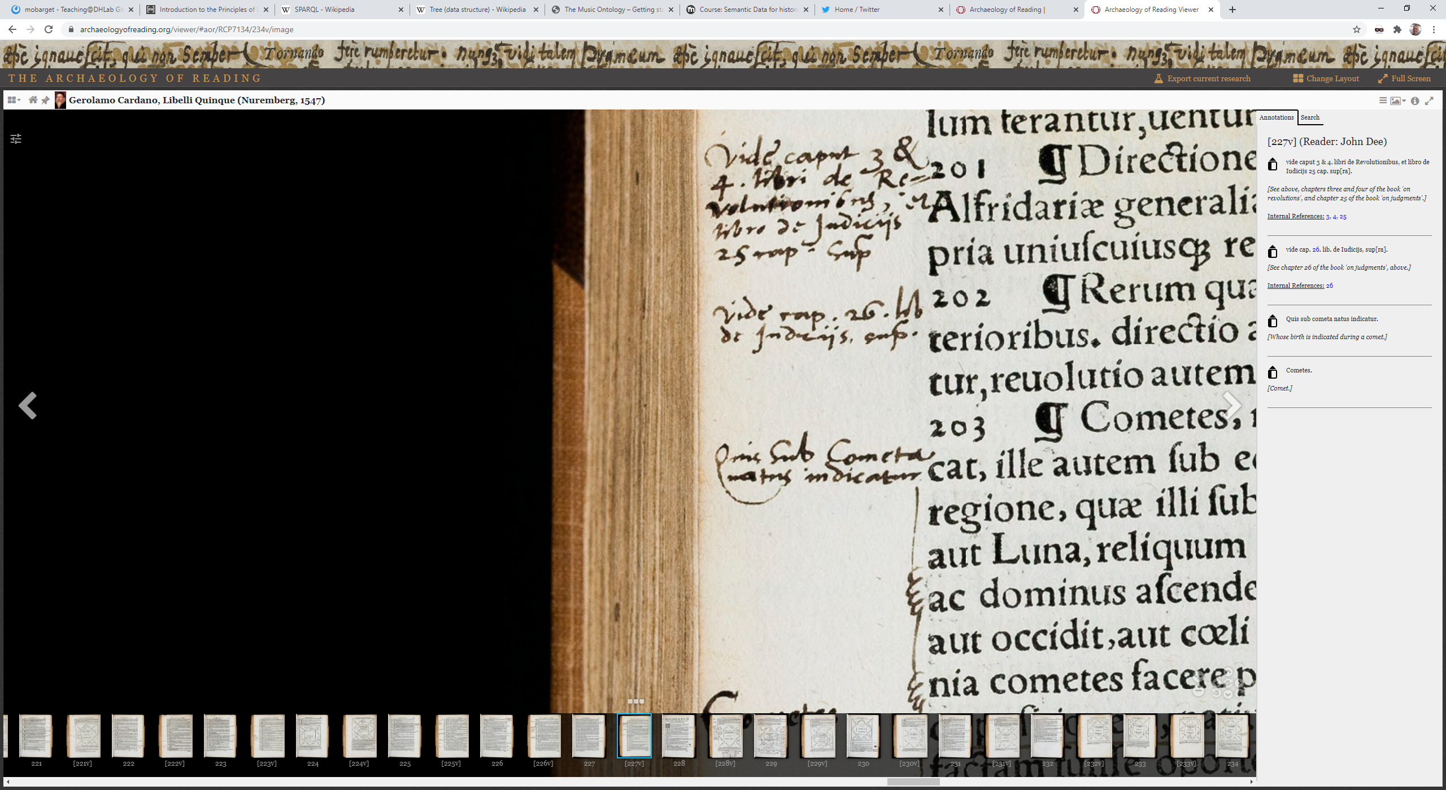
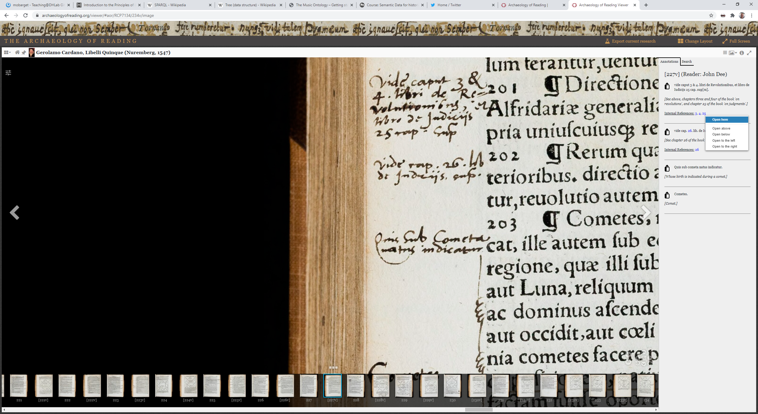
URI – AOR example
<marginalia hand="English_secretary"> <language ident="LA"> <position place="left_margin" book_orientation="0"> <marginalia_text>vide caput 3 &amp; 4. libri de Revolutionibus, et libro de Iudicijs 25 cap. sup[ra].</marginalia_text> <internal_ref> <target ref="RCP7134:184" text="3"/> <target ref="RCP7134:186" text="4"/> <target ref="RCP7134:168" text="25"/> </internal_ref> </position> </language> <translation>See above, chapters three and four of the book 'on revolutions', and chapter 25 of the book 'on judgments'.</translation> </marginalia>
RCP7134:184 = URI! RCP7134 is the ID of the book (see here); 184 is the page number

Slide 8
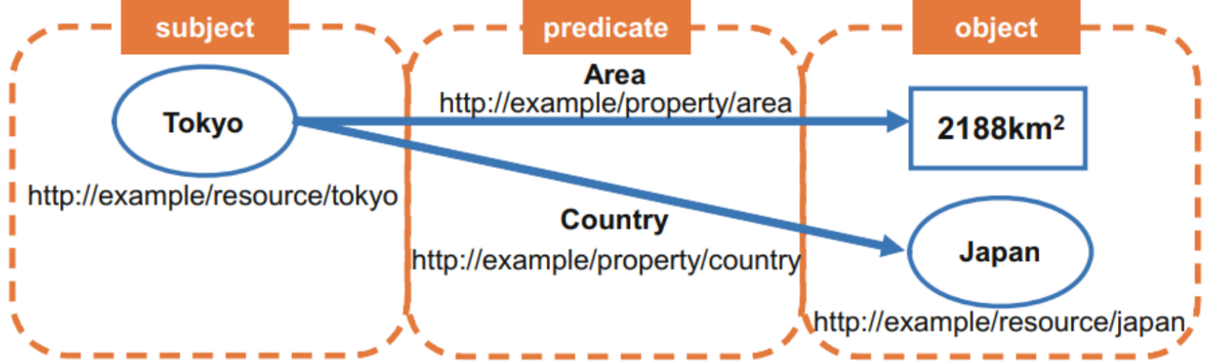
Resource Description Framework (RDF)
RDF is a data model (specific way to describe and organize data)
RDF is XML
RDF has several ‘serializations’ (e.g. RDF XML, Turtle)
Based on ‘triples’
Subjects can be objects of other statements, and vice versa
Source: click here.

Slide 9
RDF/XML
RDF Resource, Property, and Property Value
RDF identifies things using Web identifiers (URIs), and describes resources with properties and property values.
A Resource is anything that can have a URI, such as "https://www.w3schools.com/rdf"
A Property is a Resource that has a name, such as "author" or "homepage"
A Property value is the value of a Property, such as "Jan Egil Refsnes" or "https://www.w3schools.com" (note that a property value can be another resource)
(source: https://www.w3schools.com/xml/xml_rdf.asp)

Slide 10
RDF/XML
“A recipe has the name XXX” (recipe = subject; has the name = predicate, XXX = object)
<rdf:rdf xmlns:rdf="http://www.w3.org/1999/02/22-rdf-syntax-ns#" xmlns:recipe="http://jg.dhlab.de/Teaching/recipe.xsd">
<description about= "recipe" name= "Apple pie" /> <!-- description of resource defined in the about attribute; name as property-->
</rdf>
<rdf:rdf xmlns:rdf="http://www.w3.org/1999/02/22-rdf-syntax-ns#" xmlns:recipe="http://jg.dhlab.de/Teaching/recipe.xsd">
<description about= "recipe" >
<recipe:name= "Apple pie" /> <--different way to define a property of the resource-->
</description>
</rdf>
<rdf:rdf xmlns:rdf="http://www.w3.org/1999/02/22-rdf-syntax-ns#" xmlns:recipe="http://jg.dhlab.de/Teaching/recipe.xsd">
<description about= "recipe" >
<recipe:name>Apple pie</recipe:name>
<recipe:ingredient>Apple</recipe:ingredient>
</description>
</rdf>

Slide 11
RDF/XML (2)
Shakespeare (subject) created (predicate) Two noble kingsmen
<rdf:RDF xmlns:rdf="http://www.w3.org/1999/02/22-rdf-syntax-ns#" <!-- xmlns:rdf namespace, specifies that elements with the rdf prefix are from the namespace "http://www.w3.org/1999/02/22-rdf-syntax-ns#“→
xmlns:dc="http://purl.org/dc/terms/"> <!--xmlns:dc namespace, specifies that elements with the dc prefix are from the namespace “http://purl.org/dc/elements/1.1/”, the Dublin Core Metadata Initiative-->
<rdf:Description rdf:about="http://id.loc.gov/authorities/names/no2010025398"> <!-- rdf:about describes the resource (i.e. anything that can have a URI)-->
<dc:creator rdf:resource="http://viaf.org/viaf/96994048"/> <!--object here specified as URI within property tag which contains the predicate (i.e. ‚creator‘)-->
</rdf:Description>
</rdf:RDF>
Source: https://programminghistorian.org/en/lessons/intro-to-linked-data#rdf-and-data-formats

Slide 12
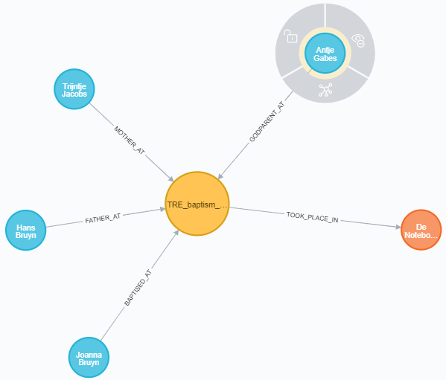
Triple in graph database

Slide 13
Ontology/vocabulary
A model which describes the relations between various types of data
Can have different serializations (e.g. DTD, XML schema, triples)
Enable us to understand datasets and link them properly

Slide 14
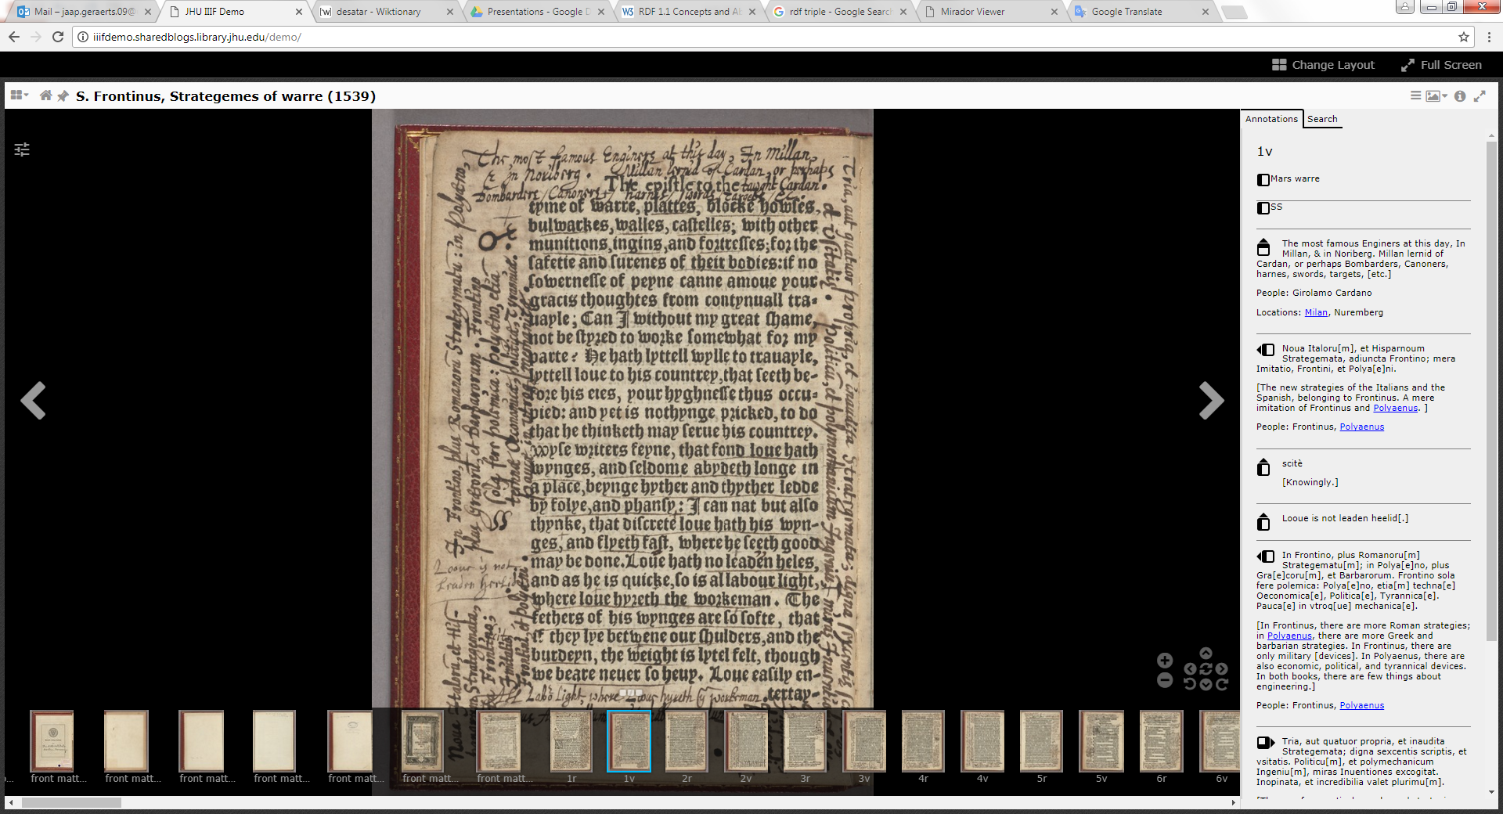
AOR – Perseus example

Slide 15
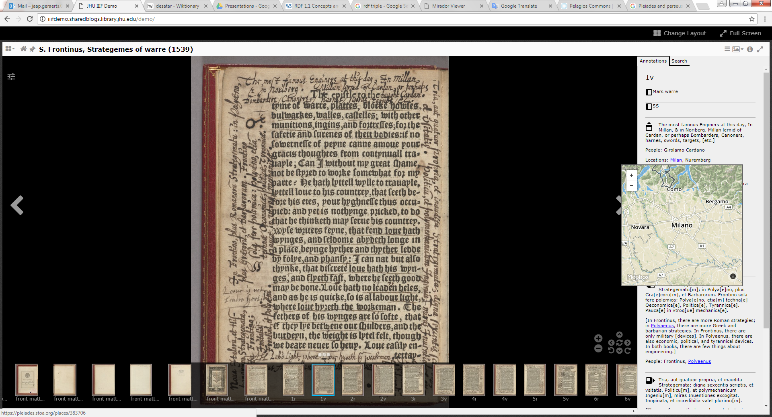
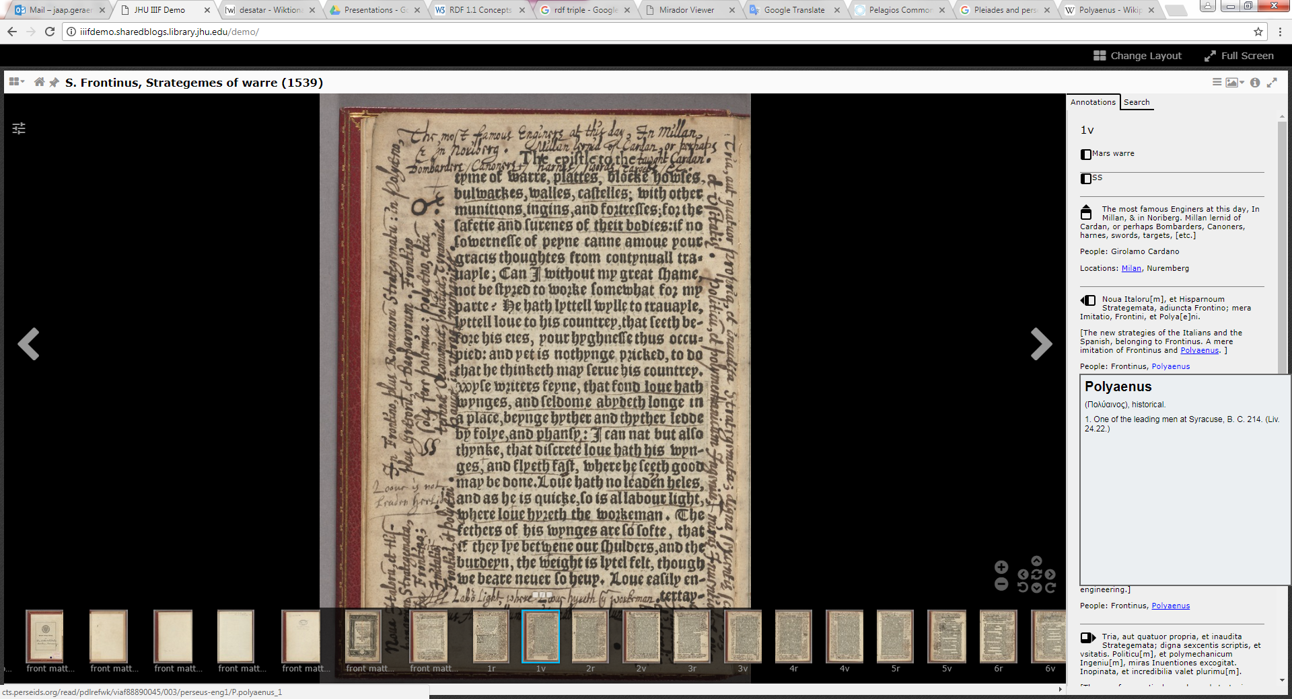
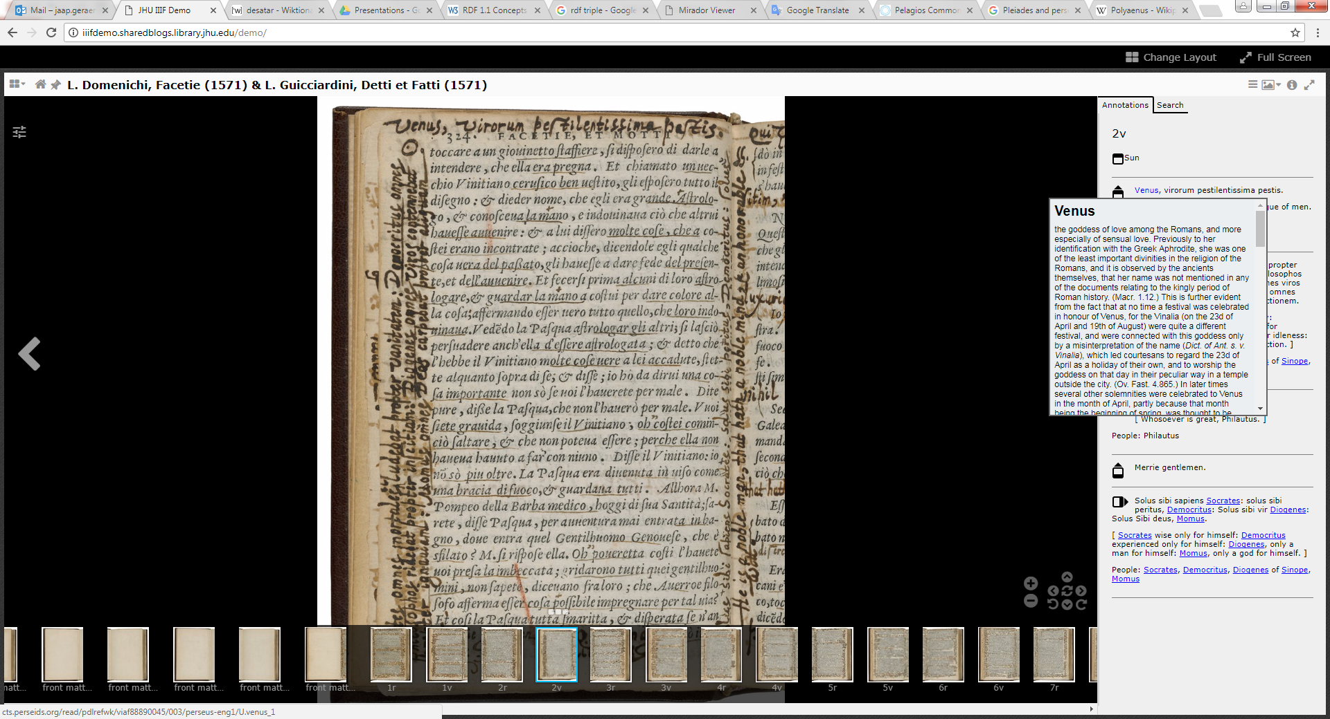
AOR – Perseus example

Slide 16
SPARQL
RDF querying language
Short and nice introduction: https://www.youtube.com/watch?v=FvGndkpa4K0
Tutorial (2): https://www.wikidata.org/wiki/Wikidata:SPARQL_tutorial

Slide 17
Sources
http://www.linkeddatatools.com/introducing-rdf-part-2 (short, but clear introduction to the basics)
http://www.contrib.andrew.cmu.edu/~mm6/95-733/PowerPoint/rdftutorial.pdf
https://www.xul.fr/en-xml-rdf.php#resource
https://www.w3schools.com/xml/xml_rdf.asp
https://programminghistorian.org/en/lessons/intro-to-linked-data
https://www.europeandataportal.eu/sites/default/files/d2.1.2_training_module_1.2_introduction_to_linked_data_de_edp.pdf (useful introduction to Linked Data, in German!)
https://www.uni-ulm.de/fileadmin/website_uni_ulm/iui.inst.090/Lehre/WS_2011-2012/SemWebGrundlagen/v02_handout.pdf (useful introduction to Linked Data, in German!)
https://port.sas.ac.uk/course/view.php?id=54
https://medium.com/wallscope/understanding-linked-data-formats-rdf-xml-vs-turtle-vs-n-triples-eb931dbe9827
https://www.youtube.com/watch?v=zeYfT1cNKQg
Linked Data and AOR: https://www.youtube.com/watch?v=CbW0hjGjjxM&feature=youtu.be

